Slide 1

Magistrate Judges Best Practices Forum
May 15, 2026
Quarry Oaks Golf Club, Ashland, NE

Slide 2



Slide 3
Opening Remarks
District Judge Brian C. Buescher
And
Magistrate Judge Ryan C. Carson
Back

Slide 4

State of the Docket – CIVIL Cases
Total filings in the district have increased approximately 22% from 2023-2025
  1,222 in 2023 to 1,492 in 2025

Slide 5
State of the Docket
  District of Nebraska covers 76,872 Sq. Miles (16th largest US state by area)
  Population of 1,961,504 (2020)
  1,001 civil filings in 2025
      Contract 117 - a 17% increase since 2023
      Tort 100 - a 17% increase since 2023
      Civil rights 174 - a 20% decrease since 2023
      Copyright/patent 21- no change
      Social Security 59- a 119% increase since 2023
  Median time (months from filing to disposition)
      2023- 6.8
      2024- 8.6
      2025- 5.5 (lowest median time in the 8th Circuit)
  The Magistrate Judges handled almost 2,800 civil matters in 2025
      Ranked 8th nationally for total duties
      Ranked 14th nationally for civil duties
      9th nationally for felony pretrial matters (3,336)
      16th nationally for felony preliminary proceedings (3,473)

Slide 6

Rule 26(f) Report
Magistrate Judge Michael D. Nelson
Rule 26(f) Report
  https://www.ned.uscourts.gov/forms?page=2
https://www.ned.uscourts.gov/attorney/rule-26f-report-calculator

Slide 7

Case Progression
USDC Nebraska Magistrate Judges
  Final Progression Orders
  Case Status Conferences
  Trial Settings
  Pending Dispositive Motions
  Continuances
  CJRA
Next

Slide 8
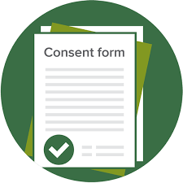
Consent to Magistrate Judge
The Local Rule re consent
73.1 Magistrate Judge; Trial by Consent.
(a) Random Assignment.
Unless ordered otherwise, the clerk assigns each civil action to a district or magistrate judge by automated random selection. When the clerk assigns an action to a magistrate judge, each party must file either (1) a consent to the referral to the magistrate judge under 28 U.S.C. § 636(c) or (2) an election for reassignment to a district judge. The parties may indicate on Form 35 (the Rule 26(f) report) or other consent form provided by the court whether they consent to trial before a magistrate judge. Failure to timely return the election form will result in case reassignment to a district judge. Consent to a magistrate judge's authority does not constitute a waiver of any jurisdictional defense unrelated to the grant of authority under 28 U.S.C. § 636(c).
Stat Consent to Random Assignment to Magistrate Judge.pdf
(b) Reassignment of Case to Magistrate Judge.
The clerk notifies the parties in a case assigned to a district judge that under 28 U.S.C. § 636(c) they may consent to have a magistrate judge (1) conduct any proceedings in the case, including a jury or nonjury trial, and (2) enter final judgment. This notice is provided as soon as practicable after the case is filed and before the case is first scheduled for trial. If all parties consent on the required form to proceed before the magistrate judge, the clerk notifies the district judge of the consent. The district judge considers the consent and reassigns the case to the magistrate judge if appropriate.
Consent to Reassignment to Magistrate Judge.pdf

Slide 9
FINAL PRETRIAL CONFERENCE - NECivR 16.2
Magistrate Judge Jacqueline M. DeLuca
4-6 weeks prior to trial
In Person/By Zoom
Deadline to submit materials to chambers set in trial setting order
Consult the local rules and forms provided

Slide 10
EXHIBIT LISTS
NECivR 16.2(1)(A)
Exhibits and Exhibit Lists must be exchanged between parties in advance of deadline to submit joint pretrial order (See NECivR 16.2(a)(1))
  Allow enough time to mark objections prior to submitting to MJ
Objections not included will be waived – exception 402 & 403
  R: Relevancy H: Hearsay A: Authenticity O: Other (be sure to specify)
Exhibit List form provided on the court’s website
Number starting at 1. Ex. 101, 501, etc. (See NECivR 39.3(d))

Slide 11

FINAL PRETRIAL ORDER
NECivR 16.2(a)(2)
Form available on court’s website
Joint submission
Witness lists –
  Include city and state
  Indicate “will call” or “may call”
  Indicate if party requests witness testify remotely and notate whether the request is opposed
Experts –
  Attach a copy of the witness’s CV

Slide 12
Case Filings: “Help Us Help you”
Stephanie Nevins Career Clerk to Magistrate Judge Nelson
Tess Moyer Career Clerk to Magistrate Judge DeLuca
Caitlin Wain Career Clerk to Magistrate Judge Carson

Slide 13
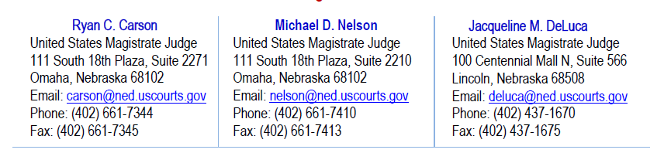
Contacting Chambers
Meet and confer with counsel – Joint requests preferred
Contact Chambers for case-specific instructions regarding scheduling, case summaries, judge preferences, etc.
Contact the Clerk’s Office with questions regarding filing

Slide 14
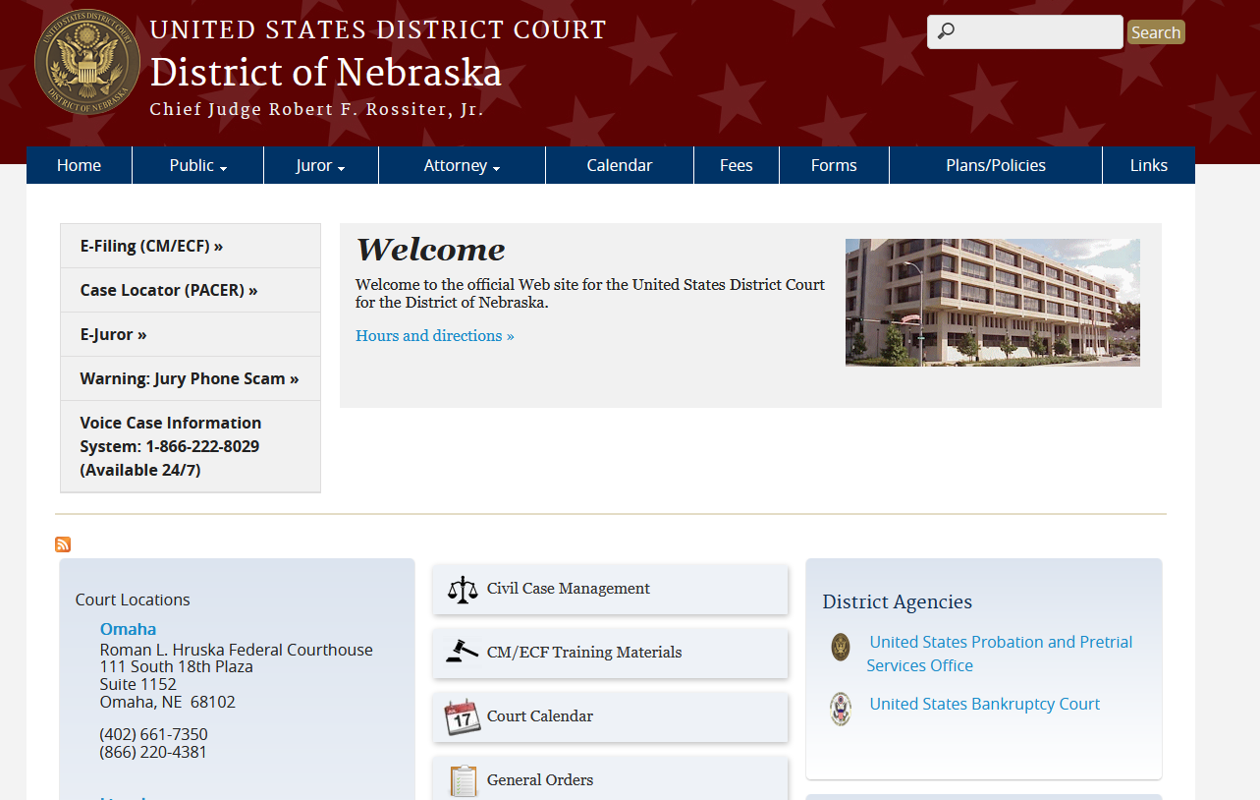
Case Management Practices

Slide 15
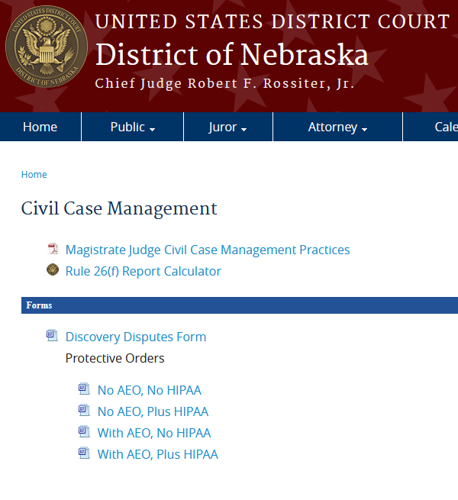

Slide 16
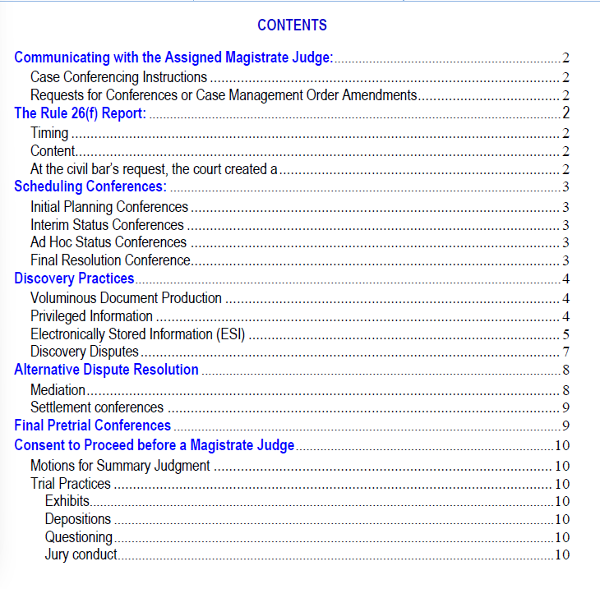

Slide 17
Motions to Amend Pleadings
Before Trial
Fed. R. Civ. P. 15:
Amendments as a matter of course: Rule 15(a)(1) – No motion necessary!
Amendments with opposing party’s written consent or the court’s leave: Rule 15(a)(2).
Fed. R. Civ. P. 16:
The progression order must include a deadline to amend the pleadings. Rule 16(b)(3).
Unless the deadline is explicitly amended by the court, once this deadline is expired, “A schedule may be modified only for good cause and with the judge’s consent. Rule 16(b)(4).”
See NECivR 7.1(a)(1) regarding when a brief should accompany a motion.

Slide 18
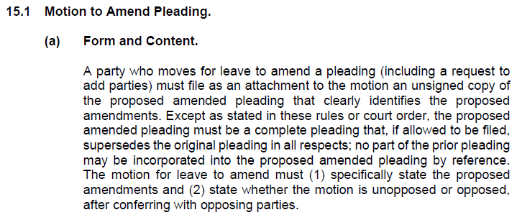
NECIVR 15.1
Motion to Amend Clerk Checklist:
Is the motion within the deadline set in the final progression order?
Is the motion opposed or unopposed?
Is an unsigned copy of the proposed amended pleading attached?
Are amendments clearly identified in the attachment? (Redlines)

Slide 19
Restricted Documents
NECivR 5.3(c), NEGenR 1.3(a)(1)(A)
Previous Features:
  Notice of Electronic Filing sent to case participants
  Entry noting the restricted access appears on the public docket
  Only parties of record and court users may routinely access the document electronically
Changes Effective September 18, 2025
  General Order No. 2025-04, In Re Procedures for the Storage and Management of Restricted and Sealed Documents, changed document retention policies due to an escalation in cyberattacks
  Parties will receive notices of electronic filing when such documents are filed in their cases, however the documents themselves will not be accessible or viewable electronically
  Parties must now separately serve restricted documents on those entitled to receive notice
  The Clerk will serve restricted and sealed orders and judgments in paper by mail
Motion to Restrict Access Under the E-Government Act of 2002
  Motion must state why filing an unredacted document is necessary and why redaction would not reduce or eliminate the need for restriction
  Restricted document MUST NOT be attached to the motion. It must be filed as a separate, provisionally restricted document. NECivR 5.3(c)(1)(B)

Slide 20

Sealed Documents
NECivR 7.5, NEGenR 1.3(a)(1)(A)
  Features:
    Docket entry is only visible to the Court
    CM/ECF does not provide notice of electronic filing to parties
    Neither the parties nor the public can electronically access the document
  Motion to Seal:
    Must state why sealing is required and whether redaction could eliminate or reduce the need for sealing
    Not required if the document is already subject to a protective order or must be sealed by federal statute, rule of procedure, or standing order of the court. NECivR 7.5(a)(1)
    Sealed document MUST NOT be attached to the motion. It must be filed as a separate, provisionally sealed document. NECivR 7.5(a)(2)
  For proposed Protective Orders, consider whether Sealing vs. Restricting Access to Confidential Discovery Material is appropriate
  Motion to Unseal:
    Parties may file a motion to unseal or to view a docket entry upon legal grounds.

Slide 21
Restricted Access vs. Sealed Filings at a Glance
 | Restricted Access | Sealed
Local Rule | NECivR 5.3(c), NEGenR 1.3(a)(1)(A) | NECivR 7.5, NEGenR 1.3(a)(1)(A)
Accessible by public? | No | No
Accessible by parties? | Not anymore | No
Electronic Docket Sheet Entry | Entry noting restricted access appears on the public docket | Entry appears only for court users
Electronic notice generated? | Yes, but parties now must serve by other means than CM/ECF | No

Slide 22
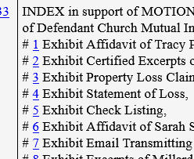
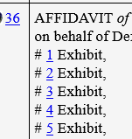
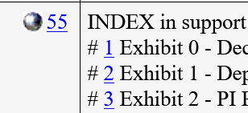


Filing Tips
Let us know if a motion is opposed or unopposed
  Include even if you don’t know!
Evidence and Evidence Index. NECivR 7.1 (a)(2)
  Provide electronic copies to chambers!

Slide 23
More Filing Tips
If you are requesting that the Court take some affirmative action or grant any relief, file a Motion
  Do not file a “Letter” or “Notice” as neither will provide the Court with a gavel alerting it to take action

Slide 24
Filing Tips Continued
The event type you choose triggers certain actions in the system
Motions for Summary Judgment/Motions to Dismiss
  The system automatically sets briefing deadlines if you choose the correct event
Only use the “Motion for Extension of Time to File Responsive Pleading” event type when asking to extend your answer deadline
  Use a “Motion to Extend” for any other extension (i.e. to extend a brief deadline)
Do not file a brief opposing a motion as an objection
  The party opposing a motion must not file an “answer," "opposition," "objection," or "response," or any similarly titled responsive filing. File it as a brief. NECivR 7.1(b)(1)(A)
If you do not know what event to use, call our chambers or the Clerk’s Office

Slide 25
Noncompliant Filings:
Failure to Follow Local Rules and Case Management Practices
TEXT ORDER denying Plaintiff's Motion for Leave to File a Second Amended Complaint without prejudice to refiling the motion indicating whether the motion is opposed or unopposed, and with the proposed amendments clearly identified in the unsigned proposed amended pleading. (See NECivR 15.1(a)).
TEXT ORDER denying Motion to Compel for failure to comply with the Court's final progression order, which provides, "A motion to compel...shall not be filed without first contacting the chambers of the undersigned magistrate judge to set a conference for discussing the parties' dispute." Filing No. XX is deemed stricken.

Slide 26
Miscellaneous
Show Cause Orders
  Failure to file proof of service or signed waiver within 90 days. See Fed. R. Civ. P. 4(m)
  Subject Matter Jurisdiction
    Court has independent obligation to review for SMJ
    Common mistakes when pleading diversity jurisdiction
      Failing to plead amount in controversy
      Failing to properly plead citizenship
        Diversity must exist at time of commencement of suit, not removal
        Resident and citizen are not interchangeable terms
        LLCs : How do you plead its citizenship?
  Failure to prosecute
    Timely move for clerk’s entry of default after answer deadline passes
    Timely move for default judgment after obtaining clerk’s entry of default

Slide 27

District Mediation Plan
  Court's Mediation Plan.pdf
Mediation Training
  August 12-14, 2026, at Hruska Federal Courthouse in Omaha
  https://lifelong.creighton.edu/browse/all-courses/live/law/courses/2026mediationtraining
Settlement Conferences with Magistrate Judge
  Complexity of Issues
  Complexity of Participants
  Limited Resources
  Previous ADR
  Pending Motions
  Timing
    Early stages
    After discovery/before dispositive motions
    After dispositive motions/before trial

Slide 28

Local Rules Changes and
Future Rules Amendments
Marcia Washkuhn
Summary of 2025 Local Rules Amendments
Proposed Rule Amendments
https://www.ned.uscourts.gov/attorney/local-rules
What additions to the local rules should we consider to help streamline the discovery process for you?
If you have suggestions for revisions, please send them to Roger Mastalir (roger_mastalir@ned.uscourts.gov) no later than June 5, 2026.

Slide 29

BREAK
Please use the QR code below to submit questions to the panel moderators.
Suggestions for Federal Practice Committee Proposal to Local Rules Committee

Slide 30
Panel Discussion
Panel Members:
Magistrate Judge Michael D. Nelson
Magistrate Judge Jacqueline M. DeLuca
Magistrate Judge Ryan C. Carson
Moderators:
Marcia Washkuhn and Kathleen Neary

Slide 31
Panel Discussion
Magistrate Judge Discovery Dispute Practices
  Case Management Practices
    https://www.ned.uscourts.gov/attorney/judges-information/civil-case-management
  Standards
    Discretion
    Objection
    Conflict over decreased standard upon objection

Slide 32
Expert Witness Disclosures (hybrid or otherwise)
  Petrone v. Werner Enters., Inc., 940 F.3d 425, 435 (8th Cir. 2019) (“Rule 37(c)(1) [of the Federal Rules of Civil Procedure] addresses what to do if a party fails to disclose information as required by Rule 26(a) and attempts to use that information on a motion, at a hearing, or at a trial.”)
  The advisory committee’s note to Fed. R. Civ. P. 37(c)(1) provides that Rule 37(c)(1) “provides a self-executing sanction for failure to make a disclosure required by Rule 26(a), without need for a motion under subdivision (a)(2)(A). Paragraph (1) prevents a party from using as evidence any witnesses or information that, without substantial justification, has not been disclosed as required by Rules 26(a) and 26(e)(1). This automatic sanction provides a strong inducement for disclosure of material that the disclosing party would expect to use as evidence, whether at a trial, at a hearing, or on a motion ....”
  Rule 26(a)(2) provides that a party must disclose the identity of any expert witness along with a written report of such expert, while Rule 26(e) imposes an obligation on the parties to supplement incorrect or incomplete information. Rule 26 also establishes the timing and sequence of such disclosures absent a court order setting these deadlines. Under Rule 16, a court “must issue a scheduling order” and such an order “must limit the time to ... complete discovery[ ] and file motions.” Fed. R. Civ. P. 16(b)(1), (3)(A). “The scheduling order may ... modify the timing of disclosures under Rule 26(a) ... [and] set dates for pretrial conferences and for trial[.]” Fed. R. Civ. P. 16(b)(3)(B)(i), (vi). A “district court has broad discretion in establishing and enforcing the deadlines.” Marmo v. Tyson Fresh Meats, Inc., 457 F.3d 748, 759 (8th Cir. 2006). However, “[a] schedule may be modified only for good cause and with the judge's consent.” Fed. R. Civ. P. 16(b)(4); Marmo, 457 F.3d at 759. In other words, the “good-cause standard is not optional.” Sherman, 532 F.3d at 716. “To establish good cause, a party must show its diligence in attempting to meet the progression order.” Marmo, 457 F.3d at 759.

Slide 33
Proportionality
  Federal Rule of Civil Procedure 1 provides, “These rules govern the procedure in all civil actions and proceedings in the United States district courts, except as stated in Rule 81. They should be construed, administered, and employed by the court and the parties to secure the just, speedy, and inexpensive determination of every action and proceeding.”
  Federal Rule of Civil Procedure 26(b)(1) provides the scope of discovery:
(b) Discovery Scope and Limits.
    (1) Scope in General. Unless otherwise limited by court order, the scope of discovery is as follows: Parties may obtain discovery regarding any nonprivileged matter that is relevant to any party's claim or defense and proportional to the needs of the case, considering the importance of the issues at stake in the action, the amount in controversy, the parties' relative access to relevant information, the parties' resources, the importance of the discovery in resolving the issues, and whether the burden or expense of the proposed discovery outweighs its likely benefit. Information within this scope of discovery need not be admissible in evidence to be discoverable.

Slide 34
Concluding Remarks
Back

